Slide 1
Relevant stats

Slide 2





Variable
Attribute of an entity(person, place, object, …).
Value of a variable can change.
180
135
150
Height(cm)
1
25
80
Age(years)
Time

Slide 3
Variable
Numeric
Continuous
Discrete
Categorical
Ordinal
Nominal

Slide 4
Measures of central tendency
Mean, Median, and Mode

Slide 5
Mean
6, 1, 4, 3

Slide 6
Median
2, 29, 1, 6, 4

Slide 7
Mode
3, 5, 3, 7, 6, 15, 7, 3
1, 2, 1, 5, 23, 2

Slide 8
Measures of dispersion
Range, Variance, Standard Deviation, and Quartiles

Slide 9
Range
7, 9, 12, 23, 4

Slide 10
Variance & Standard Deviation
7, 2, 4, 3
4, 12, 20, 28

Slide 11
Quartiles and IQR
2, 4, 5, 6, 12, 15, 20, 22, 28
2, 4, 5, 6, 12, 15, 20, 22

Slide 12
Data Pattern/Distribution

Slide 13
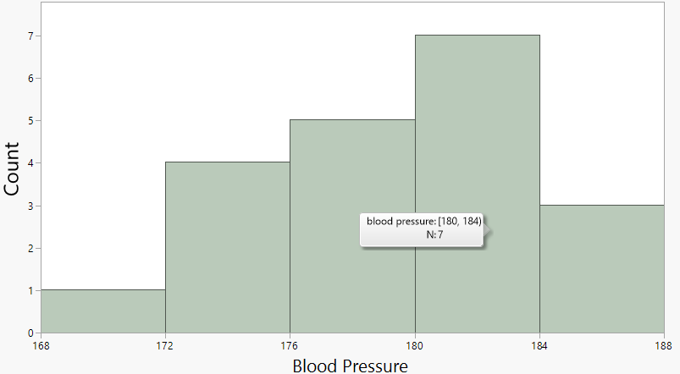
183, 173, 181, 181, 184, 171, 175, 179, 178, 181, 182, 178, 186, 175, 181, 181, 179, 177, 176, 184
Histogram

Slide 14
Data pattern
1)Center
2)Spread
3)Shape

Slide 15
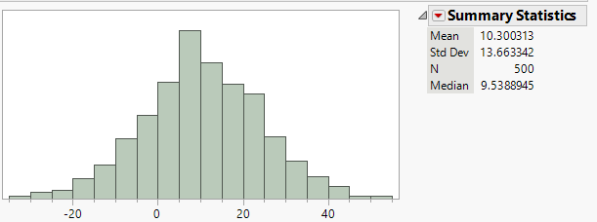
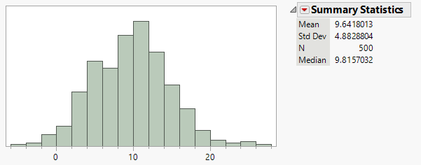
1) Center & Spread

Slide 16
Shape

Slide 17
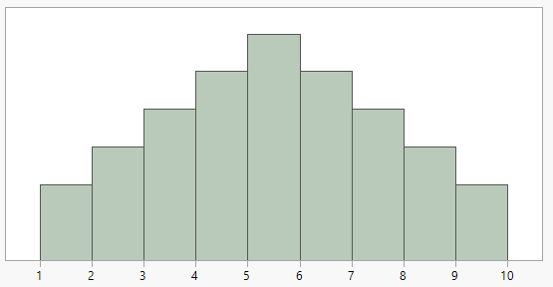
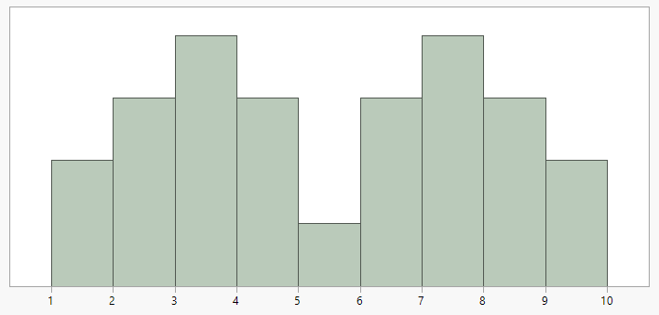
Shape-symmetry

Slide 18
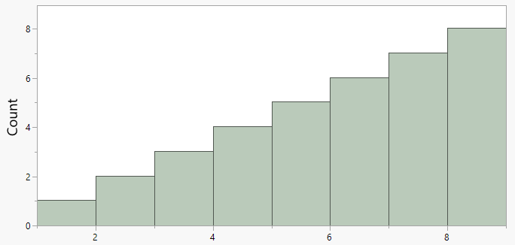
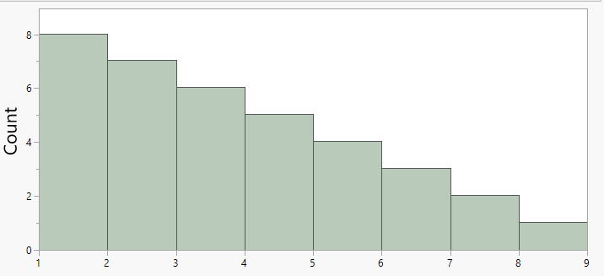
Shape-skewness
Points
Points

Slide 19
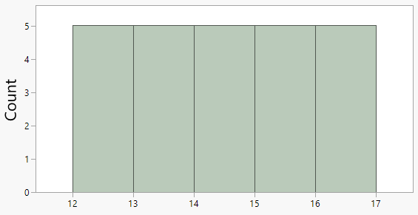
Shape -Uniform

Slide 20
Unusual features

Slide 21
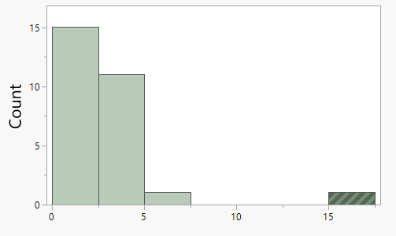
Gaps & Outliers

Slide 22
Graphs/Charts/Plots

Slide 23
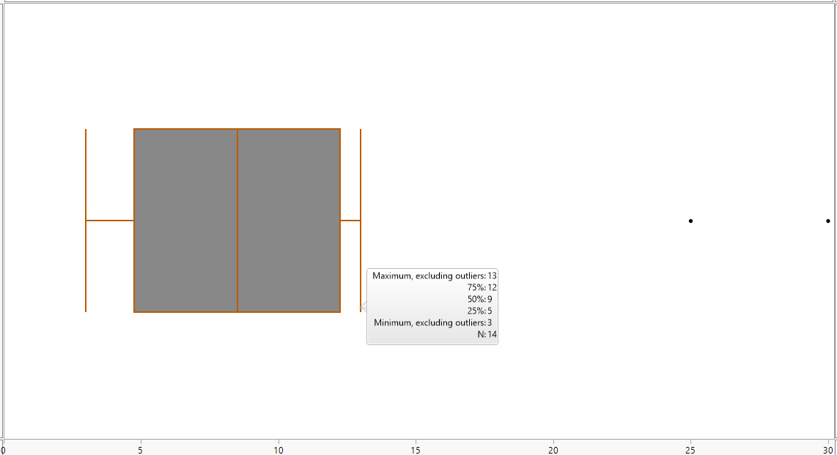
6, 3, 10, 12, 4, 9, 6, 5, 8, 4, 13, 25, 30, 9
Box plot

Slide 24
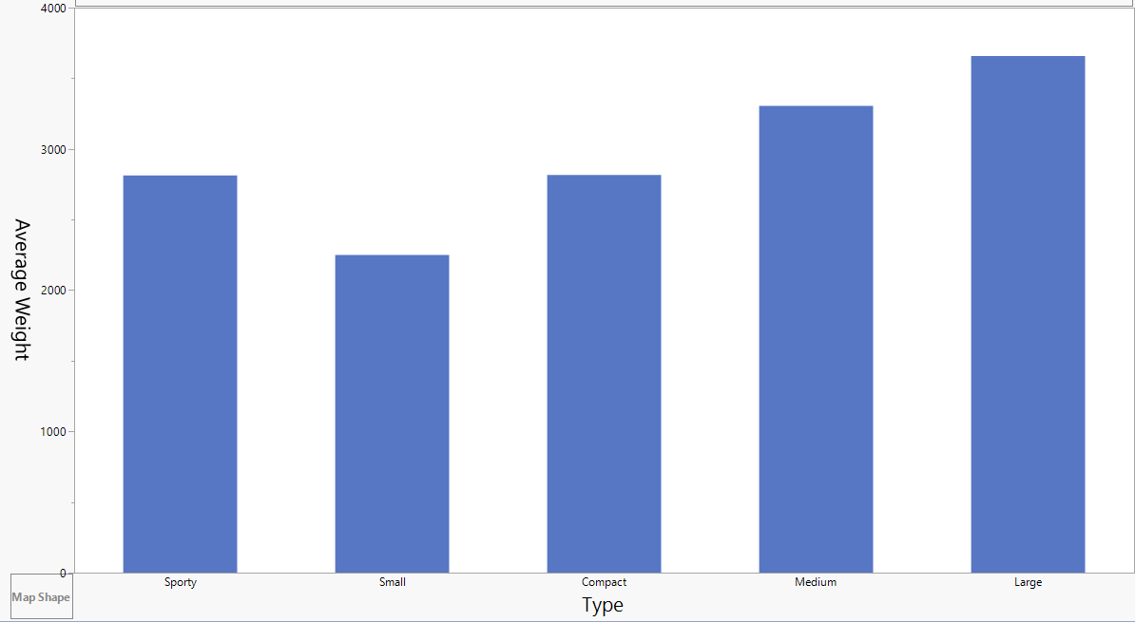
Car type | Avg weight(Kg)
Sporty | 2813
Small | 2250
Compact | 2816
Medium | 3305
Large | 3657
Bar chart

Slide 25
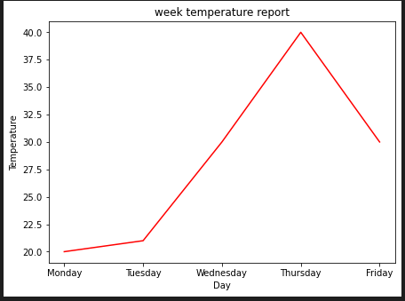
Day | Temp
Monday | 20
Tuesday | 21
Wednesday | 30
Thursday | 40
Friday | 30
Line chart

Slide 26
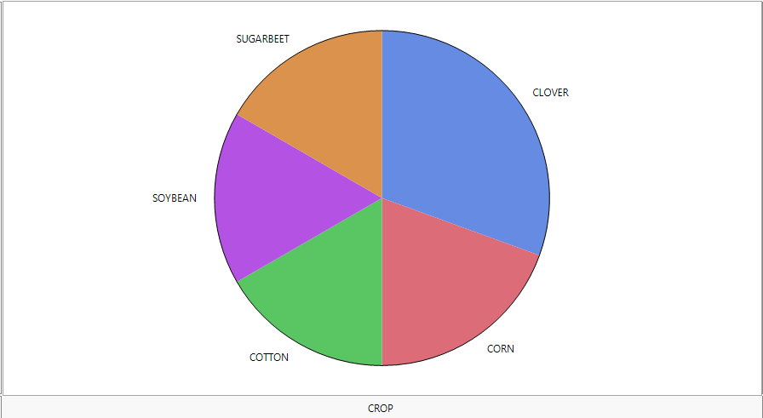
CLOVER
SOYBEAN
CORN
SUGARBEET
CLOVER
CLOVER
CLOVER
CORN
SOYBEAN
CORN
.
.
COTTON
Pie chart

Slide 27
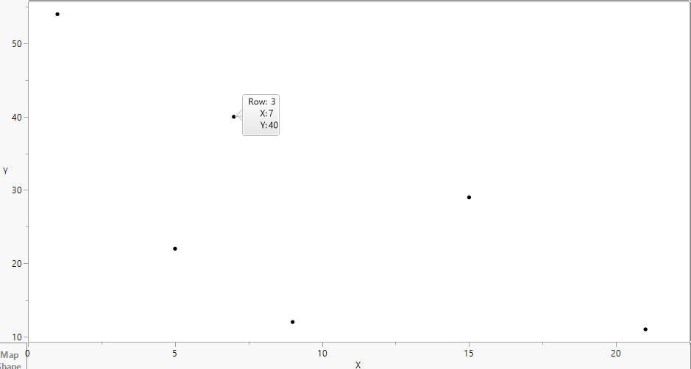
X | Y
1 | 54
5 | 22
7 | 40
9 | 12
15 | 29
21 | 11
Scatter chart

Slide 28
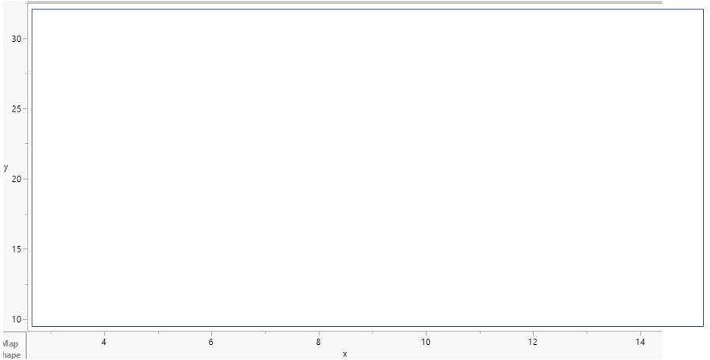

Slide 29
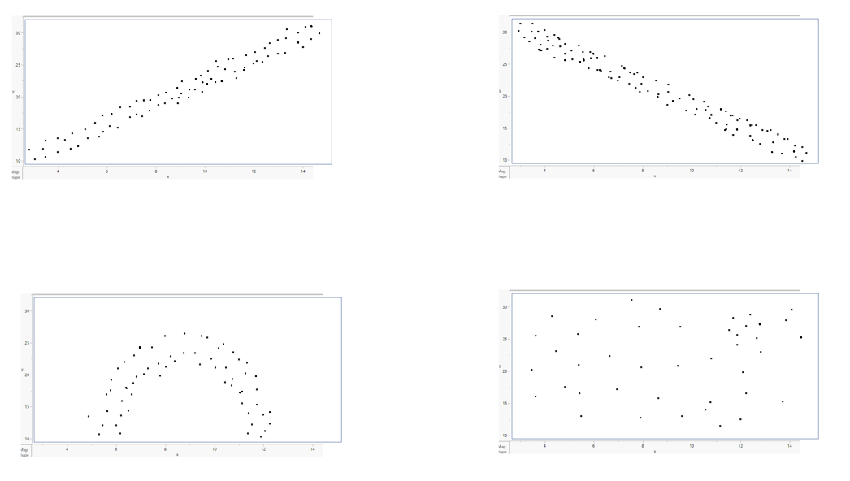

Slide 30
Population vs Sample

Slide 31













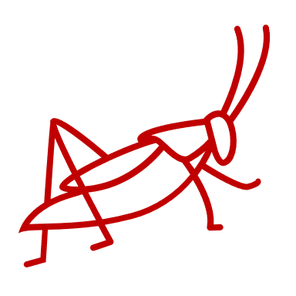


Slide 32
Symbols
 | Population parameter | Sample statistics
Size | N | n
Mean | µ | x̄
Variance | σ² | S²
Standard deviation | σ | S

Slide 33







Equations
 | Population parameter | Sample statistics
Size
Mean
Variance
Standard deviation

